Slide 1
Windows XP
CS-502 Operating Systems
Slides excerpted from Silbershatz, Ch. 22
Notes:
Assumptions:
Graduate level
Operating Systems
Making Choices about operation systems
Why a micro-century? …just about enough time for one concept

Slide 2
Windows XP™
Biggest,
…most comprehensive,
…most widely distributed
…general purpose operating system in history of computing
Affects almost all other systems, one way or another

Slide 3
Windows XP
32-bit preemptive multitasking operating system for Intel microprocessors
Key goals for the system:
  portability
  security
  POSIX compliance
  multiprocessor support
  extensibility
  international support
  compatibility with MS-DOS and MS-Windows applications.
Uses a micro-kernel architecture
Available in at least four versions: Professional, Server, Advanced Server, National Server

Slide 4
History
In 1988, Microsoft began developing “new technology” (NT) portable operating system
  Support for both the OS/2 and POSIX APIs
Originally, NT intended to use the OS/2 API as native environment
During development NT was changed to use the Win32 API
  Reflects the popularity of Windows 3.0 over IBM’s OS/2

Slide 5
Design Principles
Extensibility — layered architecture
  Executive, which runs in protected mode, provides the basic system services
  On top of the executive, several server subsystems operate in user mode
  Modular structure allows additional environmental subsystems to be added without affecting the executive
Portability —XP can be moved from on hardware architecture to another with relatively few changes
  Written in C and C++
  Processor-dependent code is isolated in a dynamic link library (DLL) called the “hardware abstraction layer” (HAL)

Slide 6
Design Principles (Cont.)
Reliability
    XP uses hardware protection for virtual memory, software protection mechanisms for OS resources
Compatibility
    Applications that follow the IEEE 1003.1 (POSIX) standard can be complied to run on XP without changing the source code
Performance
    XP subsystems can communicate with one another via high-performance message passing
    Preemption of low priority threads enables the system to respond quickly to external events
    Designed for symmetrical multiprocessing
International support
    Supports different locales via the national language support (NLS) API

Slide 7
XP Architecture
Layered system of modules
Protected mode — HAL, kernel, executive
User mode — collection of subsystems
  Environmental subsystems emulate different operating systems
  Protection subsystems provide security functions

Slide 8
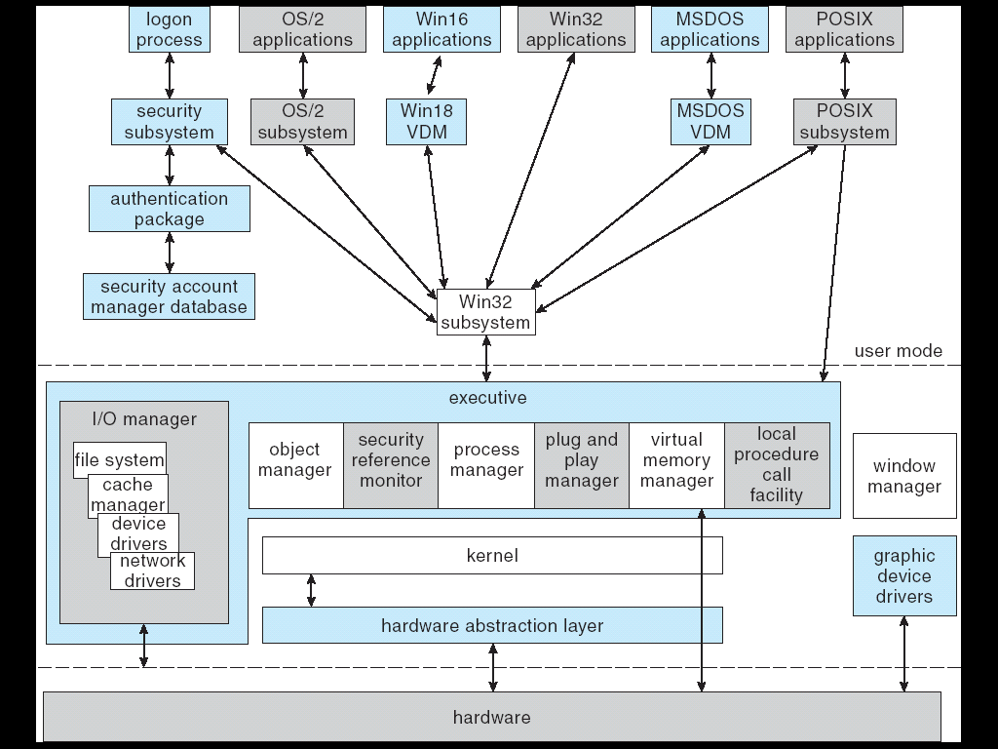
Depiction of XP Architecture

Slide 9
System Components — Kernel
Foundation for the executive and the subsystems
Never paged out of memory; execution is never preempted
Four main responsibilities:
  thread scheduling
  interrupt and exception handling
  low-level processor synchronization
  recovery after a power failure
Kernel is object-oriented, uses two sets of objects
  dispatcher objects control dispatching and synchronization
    events, mutants, mutexes, semaphores, threads and timers
  control objects
    asynchronous procedure calls, interrupts, power notify, power status, process and profile objects

Slide 10
Kernel — Process and Threads
Process
    Virtual memory address space
    Information (such as a base priority)
    Affinity for one or more processors
Threads
    Unit of execution scheduled by the kernel’s dispatcher
Thread state information
    Priority, processor affinity, and accounting information
Thread can be one of six states:
    ready, standby, running, waiting, transition, and terminated

Slide 11
Kernel — Scheduling
The dispatcher uses a 32-level priority scheme to determine the order of thread execution
  Priorities are divided into two classes
    The real-time class contains threads with priorities = 16 to 31
    The variable class contains threads with priorities = 0 to 15
Characteristics of XP’s priority strategy
  Tends to give very good response times to interactive threads that are using the mouse and windows
  Enables I/O-bound threads to keep the I/O devices busy
  Compute-bound threads soak up the spare CPU cycles in the background

Slide 12
Kernel — Scheduling (Cont.)
Scheduling can occur when
    Thread enters the ready or wait state,
    Thread terminates, or
    Application changes thread’s priority or processor affinity
Real-time threads given preferential access to CPU
But…
  XP does not guarantee that a real-time thread will start or execute within any particular time limit
  This is known as soft real-time

Slide 13
Kernel — Trap Handling
The kernel provides trap handling when exceptions and interrupts are generated by hardware of software
Exceptions that cannot be handled by the trap handler are handled by the kernel’s exception dispatcher
The interrupt dispatcher in the kernel handles interrupts by calling either
  Interrupt service routine (such as in a device driver) or
  Internal kernel routine
The kernel uses spin locks that reside in global memory to achieve multiprocessor mutual exclusion

Slide 14
Depiction of XP Architecture

Slide 15
Executive – Privileged mode
Many components
    Object Manager
    Security Reference Manager
    Process Manager
    Plug and Play Manager
    Virtual Memory Manager
    Local Procedure Call facility
    I/O Manager
      Device Drivers
    Window Manager
Too many details to cover in one hour

Slide 16
Executive — Process Manager
Provides services for creating, deleting, and using threads and processes.
Processes and threads are (almost) independent concepts
  Thread (not process) is unit of scheduling
Issues such as parent/child relationships or process hierarchies are left to the particular environmental subsystem that owns the process.

Slide 17
Executive — Local Procedure Call Facility
A message passing facility like remote procedure call
  Among separate processes
LPC passes requests and results between client and server processes within a single machine
Used to request services among various XP subsystems.

Slide 18
Executive — I/O Manager
The I/O manager is responsible for
  file systems
  cache management
  device drivers
  network drivers
Keeps track of which installable file systems are loaded, and manages buffers for I/O requests
Works with VM Manager to provide memory-mapped file I/O
Controls the XP cache manager, which handles caching for the entire I/O system
Supports both synchronous and asynchronous operations, provides time outs for drivers, and has mechanisms for one driver to call another

Slide 19
Depiction of XP Architecture

Slide 20
Environmental Subsystems
User-mode processes layered over the native XP executive services
  Enable XP to run programs developed for other operating system
XP uses the Win32 subsystem as the main operating environment
  Win32 is used to start all processes
  Also provides all the keyboard, mouse and graphical display capabilities
MS-DOS environment is provided by Win32 application called the virtual DOS machine (VDM),
  A user-mode process that is paged and dispatched like any other XP thread

Slide 21
Environmental Subsystems (Cont.)
16-Bit Windows Environment:
  Provided by a VDM that incorporates Windows on Windows
  Provides the Windows 3.1 kernel routines and subroutines for window manager and GDI functions
The POSIX subsystem is designed to run POSIX applications following the POSIX.1 standard which is based on the UNIX model
OS/2 subsystems runs OS/2 applications

Slide 22
Environmental Subsystems (Cont.)
Logon and Security Subsystem
  Authenticates all users logged on to Windows XP systems
  Users are required to have account names and passwords
  The authentication package authenticates users whenever they attempt to access an object in the system
  Windows XP uses Kerberos as the default authentication package

Slide 23
File System – NTFS
Fundamental structure of NTFS is a volume
  Created by the XP disk administrator utility
  Based on a logical disk partition
  May occupy a portions of a disk, an entire disk, or span across several disks
  Striping, RAID, redundancy, etc.
All metadata, such as information about the volume, is stored in a regular file
NTFS uses clusters as the underlying unit of disk allocation
  A cluster is a number of disk sectors that is a power of two
  Because the cluster size is smaller than for the 16-bit FAT file system, the amount of internal fragmentation is reduced

Slide 24
File System — Internal Layout
NTFS uses logical cluster numbers (LCNs) as disk addresses
A file in NTFS is not a simple byte stream, as in MS-DOS or UNIX, rather, it is a structured object consisting of attributes
Every file in NTFS is described by one or more records in an array stored in a special file called the Master File Table (MFT)
Each file on an NTFS volume has a unique ID called a file reference.
  64-bit quantity that consists of a 48-bit file number and a 16-bit sequence number
  Can be used to perform internal consistency checks
The NTFS name space is organized by a hierarchy of directories; the index root contains the top level of the B+ tree

Slide 25
File System — Recovery
All file system data structure updates are performed inside transactions that are logged
  Before a data structure is altered, the transaction writes a log record that contains redo and undo information
  After the data structure has been changed, a commit record is written to the log to signify that the transaction succeeded
  After a crash, the file system data structures can be restored to a consistent state by processing the log records

Slide 26
File System — Recovery (Cont.)
This scheme does not guarantee that all the user file data can be recovered after a crash, just that the file system data structures (the metadata files) are undamaged and reflect some consistent state prior to the crash
The log is stored in the third metadata file at the beginning of the volume
The logging functionality is provided by the XP log file service

Slide 27
More on NTFS
Security
Fault-tolerance
Striping
Mirroring
Compression
…
Too much for one hour

Slide 28
Networking
XP supports both peer-to-peer and client/server networking; it also has facilities for network management
To describe networking in XP, we refer to two of the internal networking interfaces:
  NDIS (Network Device Interface Specification) — Separates network adapters from the transport protocols so that either can be changed without affecting the other
  TDI (Transport Driver Interface) — Enables any session layer component to use any available transport mechanism
XP implements transport protocols as drivers that can be loaded and unloaded from the system dynamically
Also too much detail for one hour …

Slide 29
End

